Slide 1
Electronic Devices
Mid Term Lecture - 07
Faculty Name: Dr. Mohammad Alif Arman
Email : dr.alifarman@aiub.edu
Room: DN0526
Reference book:
Electronic Devices and Circuit Theory (Chapter-3)
Robert L. Boylestad and L. Nashelsky , (11th Edition)

Slide 2
P
N
P
Emitter
Collector
Base
The term bipolar indicates that, both electrons and holes contributes to the flow of current.
Three doped regions. The Emitter, the Base and the Collector.
Based on the doping of these three regions, it is known as either NPN or PNP transistor.
There are two PN junctions.

Slide 3
HOLES
ELECTORNS
P
N
P
Emitter
Collector
Base

Slide 4
P
N
P
Emitter
Collector
Emitter Heavily Doped
Base Lightly Doped and Very Thin
Collector Moderately Doped
Base
C
In case of the NPN transistor, the current will flow from the Base towards the Emitter.
PNP transistor, then the current will flow from the Emitter towards the Base region.
N
P
N
B
E
C
P
N
P
B
E

Slide 5
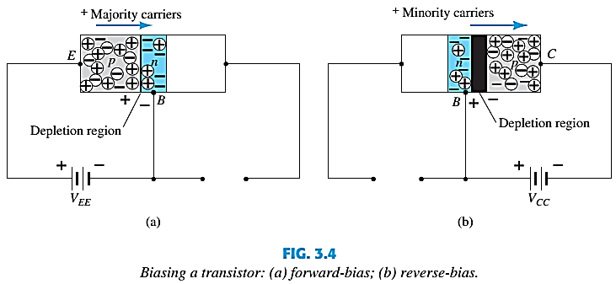
TRANSISTOR OPERATION
The basic operation will be described using the p-n-p transistor.
The operation of the n-p-n transistor is exactly the same if the roles played by the electron and hole are interchanged.
One p-n junction of a transistor is reverse-biased, whereas the other is forward-biased.

Slide 6
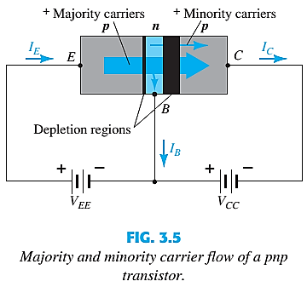
TRANSISTOR OPERATION
Both biasing potentials have been applied to a p-n-p transistor and resulting majority and minority carrier flows indicated.
Majority carriers (+) will diffuse across the forward-biased p-n junction into the n-type material.
A very small number of carriers (+) will go through n-type material to the base terminal. Resulting I_{B} is typically in order of microamperes.
The large number of majority carriers will diffuse across the reverse-biased junction into the p-type material connected to the collector terminal.

Slide 7


TRANSISTOR OPERATION
Majority carriers can cross the reverse-biased junction because the injected majority carriers will appear as minority carriers in the n-type material.
Applying KCL to the transistor :
The collector current comprises of two components – the majority and minority carriers
I_{CO} = I_{C} current with emitter terminal open and is called leakage current.

Slide 8
Different Region of OPERATION
Active
Region
I_{E}
I_{C}
V_{E}
P
N
P
V_{C}
Emitter
Collector
I_{B}
Base
V_{B}
Forward
Reverse
I_{E}
I_{C}
Reverse
Active Region
V_{E}
V_{C}
Emitter
P
N
P
Collector
I_{B}
Reverse
Base
Forward
V_{B}
I_{E}
I_{C}
V_{E}
P
N
P
V_{C}
Saturation Region
Emitter
Collector
I_{B}
Base
Forward
Forward
V_{B}
V_{E}
P
N
P
V_{C}
Cutoff Region
Emitter
Collector
Base
Reverse
Reverse
V_{B}

Slide 9
BJT CONFIGURATION
Common Emitter
Common Collector
C
C
Input
B
Output
B
Output
Input
E
E
Common Base
E
C
Input
Output
B

Slide 10
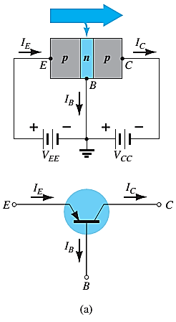
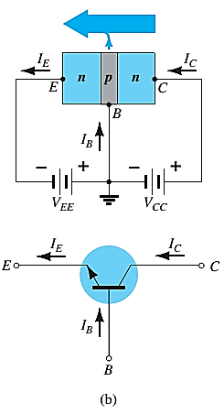
COMMON-BASE CONFIGURATION
Common-base terminology is derived from the fact that the :
- base is common to both input and output of the configuration.
- base is usually the terminal closest to or at ground potential.
All current directions will refer to conventional (hole) flow and the arrows in all electronic symbols have a direction defined by this convention.
Note that the applied biasing (voltage sources) are such as to establish current in the direction indicated for each branch.

Slide 11
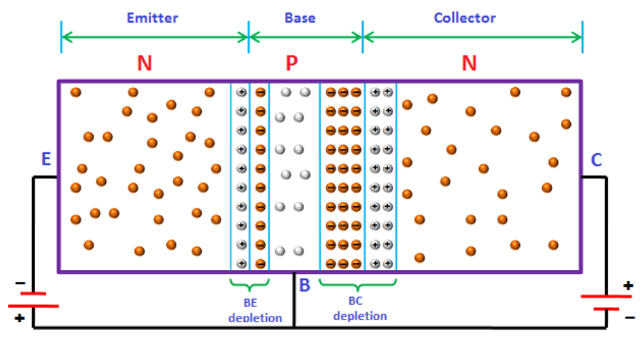
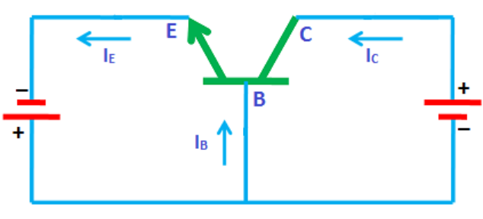
COMMON-BASE CONFIGURATION
V_{BE}
V_{CB}
The free electrons which are flowing from emitter to base.
The holes which are flowing from base to emitter. The width of the base region is very thin. A small percentage of free electrons from emitter region will combine with the holes in the base region and the remaining large number of free electrons enters to the collector region.
Free electrons of the collector region will experience an attractive force and will flow towards the positive terminal of the battery. Thus, electric current is produced in the collector region.

Slide 12
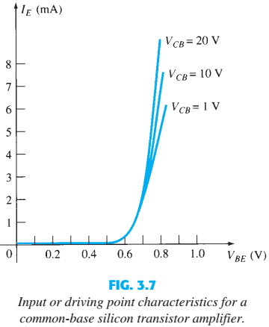
COMMON-BASE CONFIGURATION
To describe the behavior of common-base amplifiers requires two set of characteristics:
Input or driving point characteristics.
Output or collector characteristics
The output voltage V_{CB} (collector-base voltage) is kept constant at zero volts and the input voltage V_{BE} is increased from zero volts to different voltage levels.
Output voltage (V_{CB}) is increased to 10 volts. Input voltage V_{BE} is increased from 0 to different voltage levels.
When output voltage (V_{CB}) is at 0 volts and emitter-base junction is forward biased, the emitter-base junction acts like a normal p-n junction diode. So the input characteristics are same as the forward characteristics of a normal pn junction diode. The cut in voltage of a silicon transistor is 0.7 volts.
When the output voltage (V_{CB}) is increased to 10 volts, the emitter current flow will be increased (reduces the depletion region width at emitter-base junction). As a result, the turn on voltage will be reduced. Therefore, the curves shifted towards the left side for higher values of output voltage V_{CB}.

Slide 13
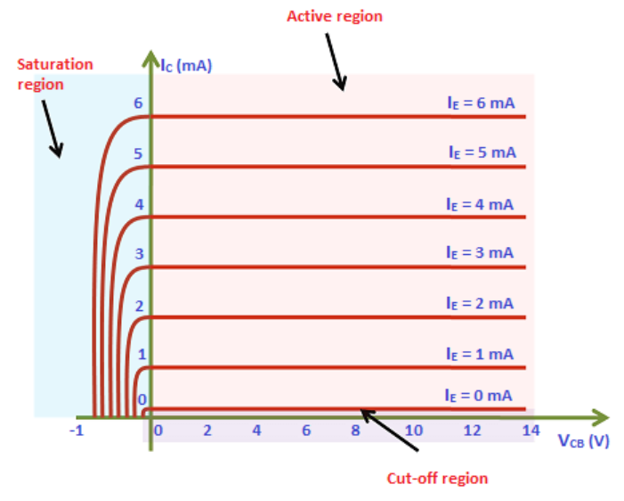
COMMON-BASE CONFIGURATION
The output characteristics has 3 basic regions:
Active region – defined by the biasing arrangements
Cutoff region – region where the collector current is 0A
Saturation region- region of the characteristics to the left of V_{CB} = 0V
Active Region: For a constant input current I_{E}, when the output voltage V_{CB} is increased, the output current I_{C} remains constant.
Saturation region:
Both emitter-base junction and collector-base junction are forward biased.
A small increase in the collector voltage V_{CB} there will be higher I_{C}. Same as PN junction.
Cutoff region:
Both are Reverse biased and so flow of current.

Slide 14
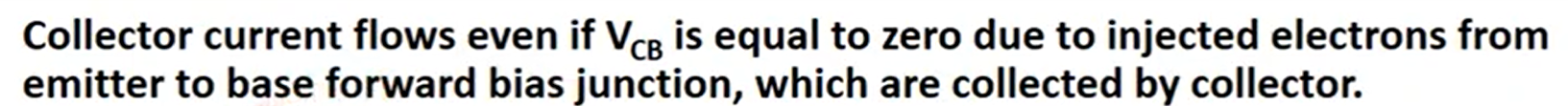
COMMON-BASE CONFIGURATION
V_{CB}=0

Slide 15
COMMON-BASE CONFIGURATION
ACTIVE REGION | SATURATION REGION | CUTOFF REGION
I_{E} increased, I_{C} increased
BE junction reverse biased and CB junction reverse biased | BE and CB junctions are forward biased | BE and CB junction are reverse biased
I_{C} ≈ I_{E} |  | No current flow at collector, only leakage current
I_{C} does not depend on V_{CB} | Small change in V_{CB} will cause big difference in I_{C}
Suitable region for the transistor to work as an amplifier | The allocation for this region is to the left of the V_{CB} = 0 V | Region below the line of I_{E} = 0

Slide 16
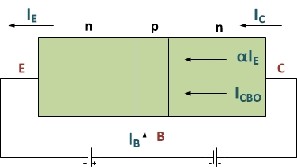
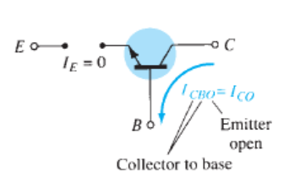
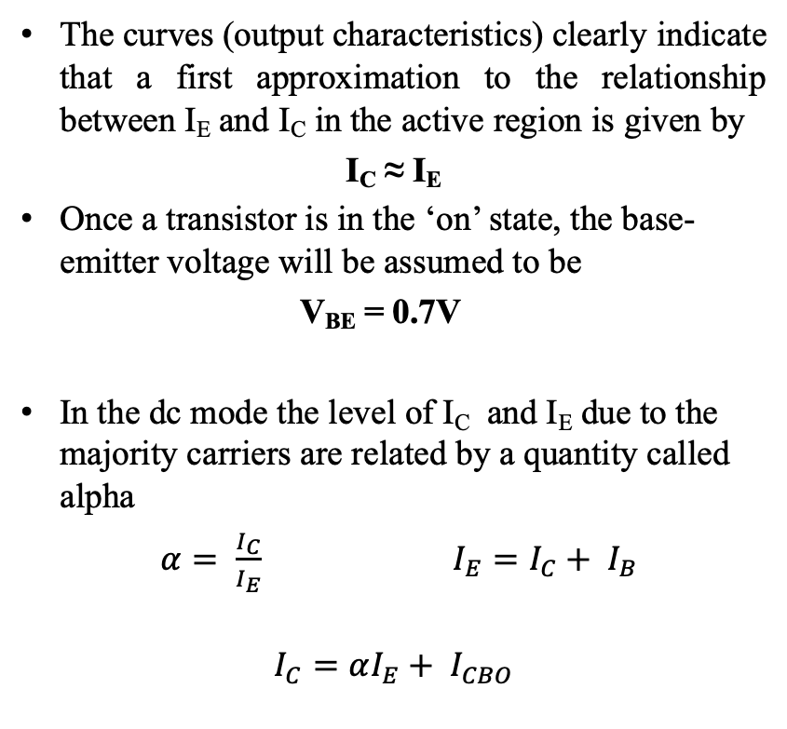
COMMON-BASE CONFIGURATION
The curves (output characteristics) clearly indicate that a first approximation to the relationship between I_{E} and I_{C} in the active region is given by
I_{C} ≈ I_{E}
Once a transistor is in the ‘on’ state, the base-emitter voltage will be assumed to be
V_{BE} = 0.7V
In the dc mode the level of I_{C} and I_{E} due to the majority carriers are related by a quantity called alpha
$α= \frac{I_{C}}{I_{E}}$ $I_{E}=I_{C}+ I_{B}$
$$I_{C}=αI_{E}+ I_{CBO}$$

Slide 17
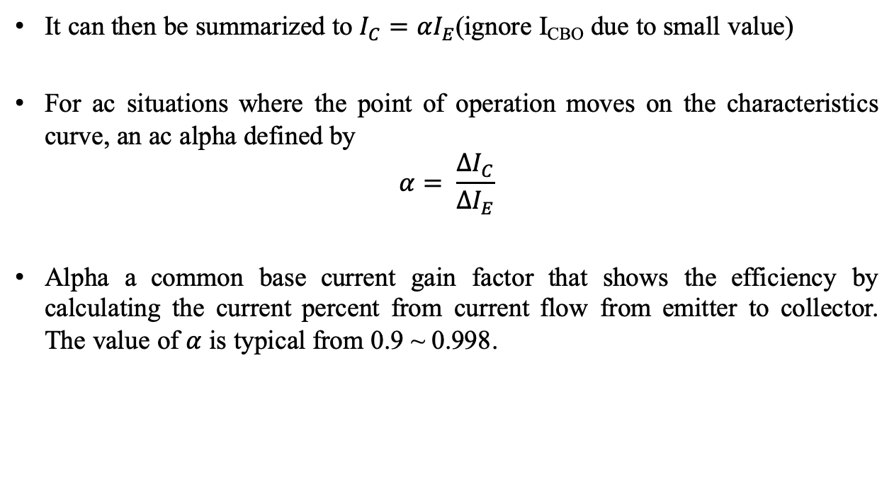
COMMON-BASE CONFIGURATION
It can then be summarized to $I_{C}=αI_{E}$(ignore I_{CBO} due to small value)
For ac situations where the point of operation moves on the characteristics curve, an ac alpha defined by
$$α= \frac{{∆I}_{C}}{{∆I}_{E}}$$
Alpha a common base current gain factor that shows the efficiency by calculating the current percent from current flow from emitter to collector. The value of $α$ is typical from 0.9 ~ 0.998.

Slide 18
Thank You

